Slide 1
Interesting case
R2 สริตา จินาวงศ์ / อ. วรรณวิภา

Slide 2
Interesting case
Case : 33 year-old Thai female patient
Diagnosis : Pheochromocytoma
Operation : Open Left Adrenectomy

Slide 3
Chief complaint
ปวดศรีษะ 1 ปี ก่อนมารพ.

Slide 4
R1 History

Slide 5
History
1 ปี ก่อนมารพ. : ผู้ป่วยมีอาการปวดศรีษะที่ท้ายทอย เป็นๆหายๆ ไม่มีคลื่นไส้อาเจียน ไม่มีตาพร่าตัว ไม่มีเดินเซ ไม่มีวูบหรือหน้ามืด ไม่มีอ่อนแรง ไม่มีไข้ ไม่มีอาการกินจุน้ำหนักลด ไม่มีท้องเสีย หรือ ถ่ายเหลว มีอาการใจสั่นและเหงื่อแตกร่วมด้วย ไปรับการรักษาที่โรงพยาบาล BP~ 200/110 mmHg ได้รับยาความดันมาทาน ยังคงมีอาการปวดศรีษะพอๆเดิม และความดันไม่ลดลง แพทย์ได้วินิจฉัย Hypertension in the young และส่งตัวมารับการรักษาต่อที่ รพ รร 6

Slide 6
History

Slide 7
Past History
Underlying diseases :
Hypertension in the young ( Baseline BP 110-130/70-90 mmHg, HR 70-90 bpm)
HBV infection
Current medication :
Doxazocin (2) 2 x 4 po pc
Propanolol (10) 1 x 4 po pc

Slide 8
Past History
- No history of food and drug allergy
No history of smoking or drinking
No history of hypertension the family
No history of previous surgery
Functional class 1

Slide 9
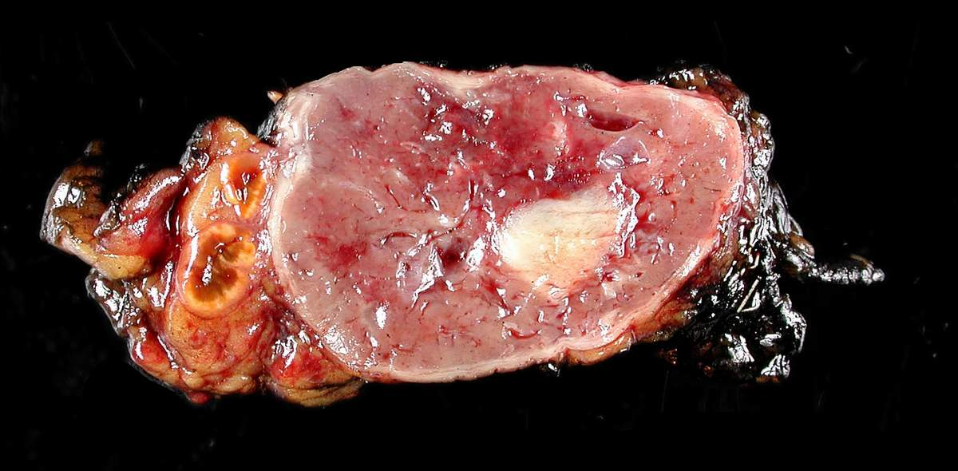
Pheochromocytoma
Catecholamine-secreting tumors of chromaffin tissue.
Only 0.1% of all cases of arterial hypertension.
Both sexes with peak incidence in the 3rd to 5th decades.
Located in the adrenal medulla or sympathetic paraganglia
“Rule of 10” 10% bilateral 10% extra-adrenal 10% familial 10% malignant
Malignant (10-20%)
Extra-adrenal (15-20%)
Familial (40%)
Gustavo F C Fagundes, Madson Q Almeida, Perioperative Management of Pheochromocytomas and Sympathetic Paragangliomas, Journal of the Endocrine Society, Volume 6, Issue 2, February 2022, bvac004

Slide 10
Pheochromocytoma
Triad :
Headache : 60%
Palpitation : 60 %
Sweating : 52 %
Gustavo F C Fagundes, Madson Q Almeida, Perioperative Management of Pheochromocytomas and Sympathetic Paragangliomas, Journal of the Endocrine Society, Volume 6, Issue 2, February 2022, bvac004

Slide 11
R1 Physical Examination

Slide 12
Physical examination
BW: 53 kg, Ht 150 cm, BMI 23.5 kg/m²
V/S : BP 110/72 mmHg, PR 68 bpm, RR 18 /min, BT 36.9 C
GA : Good consciousness, well cooperative
HEENT : Not pale conjunctivae, anicteric sclerae, no sunken eye balls, no dry lips
CVS : Normal S1S2, no murmur, pulse full and regular, no heaving, no thrill, PMI at 5th ICS

Slide 13
Physical examination
Lungs: Clear and equal breath sound both lungs, no adventitious sound
Abdomen: Soft, not tender, no palpable mass, no guarding,& normoactive bowel sound
Ext: No edema and no deformity
Neuro: E4V5M6, pupil 3 mm RTLBE, good orientation to place, time and person, Motor grade V all, Sensory intact

Slide 14
Physical examination
Airway Examination :
No limit neck motion
Mallampati grade 1
Thyromental distance > 6 cm
Mouth opening > 3 cm
No prominent incisor
Normal dental examination
Upper lip bite test class 1

Slide 15
Physical examination

Slide 16
R1 Investigation

Slide 17
Laboratory Investigation
CBC: Hb 11.7 g/dl, Hct 36.4 %, Plt 456,000/ul
BUN/Cr: 13 mg/dl, 0.74 mg/dl eGFR : 106 ml/min/1.73m²
Electrolyte: Na 137.3 mEq/l, K 3.89 mEq/l, Cl 103.6 mEq/l, HCO3 22.3 mEq/l
Ca 9.18 mg/dl
LFT: TP 8.6 g/dl, Alb 4.4 g/dl, TB 0.1 mg/dl, DB 0.07 mg/dl, AST 21 U/L, ALT 16 U/L, ALP 80 U/L
DTX : 91 mg/dl

Slide 18
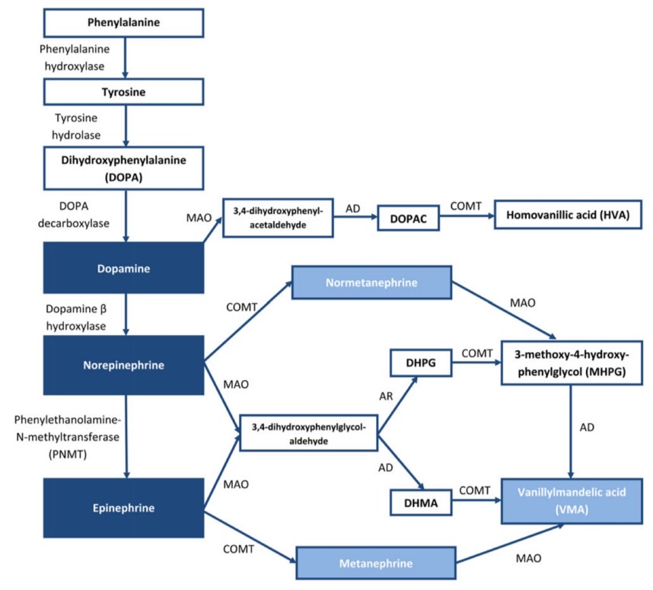

Slide 19
Laboratory Investigation
24 hr Urine
Urine volume : 1,900 ml
Creatinine (mg/dl) : 46
Urine creatinine 24 hr : 0.88 g/day (0.67-1.59)
Normetanephrine : 4699 mcg/24hr (< 549.6)
Metanephrine : 162 mcg/24hr (<276.1)

Slide 20
Chest X-ray

Slide 21
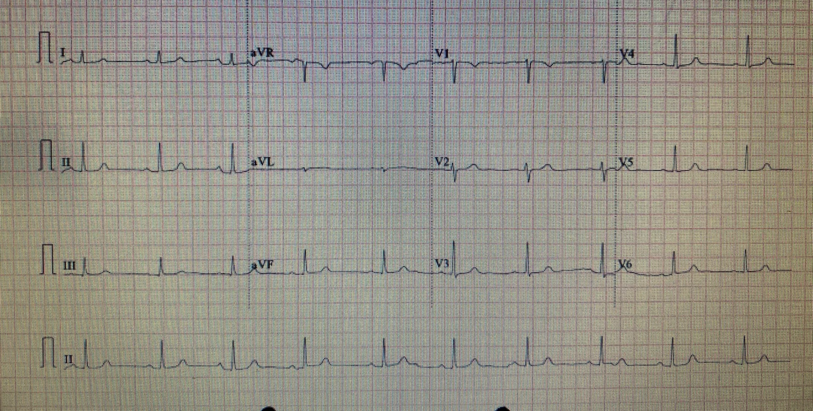
EKG

Slide 22
Laboratory Investigation
Echocardiogram : LVEF 60-65%, no significant valvular pathology

Slide 23
CT-whole abdomen
Cystic lesion with rim enhancement at left adrenal gland size 5.1x4.4x4.8 cm.
No definite evidence of adjacent organ invasion or extra-adrenal lesion.

Slide 24
MIBG study (I-131 MIBG)
Finding:
The scan at 24 and 48 after the injection of I-131 MIBG show no abnormal radiotracer uptake at the whole body.
IMPRESSION:
No evidence of MIBG avid tumor

Slide 25
R1 Problem list

Slide 26
Problem list
- Pheochromocytoma
- Underlying diseases :
HBV infection
Hypertension
ASA 2
Functional Class 1

Slide 27
R2 Preoperative evaluation

Slide 28
Patient factors
Pheochromocytoma
HBV infection

Slide 29
Pheochromocytoma
Arterial pressure control
Reversal of chronic circulating volume depletion
Heart rate and arrhythmia control
Assessment and optimization of myocardial function
Reversal of glucose and electrolyte disturbances

Slide 30
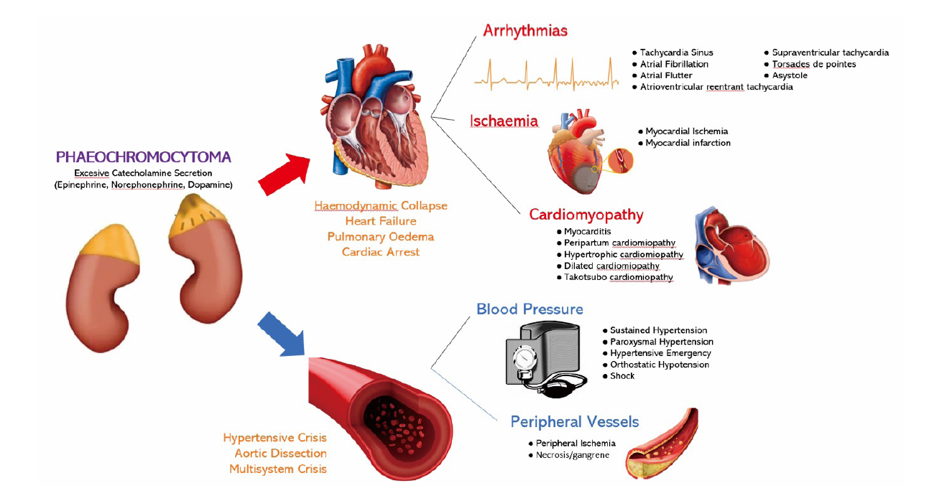
Arterial pressure control
Early phaeochromocytoma surgery
-> mortality rates up to 45%

Slide 31
Arterial pressure control
α-blockers :
Preoperative α-blockers : pre- operative arterial pressure control with subsequent restoration of blood volume
Phenoxybenzamine and doxazosin.
CCBs :
Additional drug to improve control in those already α-blocked
Not recommended for monotherapy unless patients : - have very mild hypertension or - develop severe orthostatic hypotension with α-blockers
David Connor, BMedSci BMBS FRCA, Stephen Boumphrey, MBBS FRCA, Perioperative care of phaeochromocytoma, BJA Education, Volume 16, Issue 5, May 2016, Pages 153–158

Slide 32
α-blockers :
Phenoxybenzamine
Non-competitive
Non-selective
Long acting
MUST BE Stopped 24–48 h before surgery
Doxazosin
Competitive
Selective α1-blocker
Short acting
Can be given in the morning before surgery
David Connor, BMedSci BMBS FRCA, Stephen Boumphrey, MBBS FRCA, Perioperative care of phaeochromocytoma, BJA Education, Volume 16, Issue 5, May 2016, Pages 153–158

Slide 33
Reversal of chronic circulating volume depletion
A high-sodium diet (3-5 g/d ) -> restore blood volume
Intravenous volume load with 1 to 2 liters of saline infusion in the last 24 hours prior to the surgery
Gustavo F C Fagundes, Madson Q Almeida, Perioperative Management of Pheochromocytomas and Sympathetic Paragangliomas, Journal of the Endocrine Society, Volume 6, Issue 2, February 2022, bvac004,

Slide 34
Heart rate and arrhythmia control
Tachyarrhythmias may result from epinephrine/dopamine- secreting tumours or be secondary to α-blockade.
Selective β1 antagonists (such as atenolol or metoprolol) : started after complete α-blockade.
David Connor, BMedSci BMBS FRCA, Stephen Boumphrey, MBBS FRCA, Perioperative care of phaeochromocytoma, BJA Education, Volume 16, Issue 5, May 2016, Pages 153–158

Slide 35
Assessment and optimization of myocardial function
ECG : ventricular hypertrophy, tachyarrhythmias, or myocardial ischaemia.
Echocardiography -> Diastolic dysfunction : majority of patients -> LV systolic dysfunction : 10 %
The impaired cardiac function associated with phaeochromocytoma may improve once catecholamine levels return to normal.
David Connor, BMedSci BMBS FRCA, Stephen Boumphrey, MBBS FRCA, Perioperative care of phaeochromocytoma, BJA Education, Volume 16, Issue 5, May 2016, Pages 153–158

Slide 36
Reversal of glucose and electrolyte disturbances
Hyperglycaemia :
increased glycogenolysis (α1 receptors)
impaired insulin release (α2 receptors)
lipolysis (β1 receptors)
increased glucagon release with peripheral insulin resistance (β2 receptors)
Electrolyte measurements : catecholamine-induced renal impairment.
Hypercalcaemia : neuroendocrine tumour is associated with a parathyroid adenoma
David Connor, BMedSci BMBS FRCA, Stephen Boumphrey, MBBS FRCA, Perioperative care of phaeochromocytoma, BJA Education, Volume 16, Issue 5, May 2016, Pages 153–158

Slide 37
Assessment of adequate optimization
α-Blockade is commenced at least 7–14 days before surgery. -> achieve arterial pressure control with restoration of volume.
1982 Roizen criteria for optimal preoperative control:
Arterial pressure consistently <160/90 mmHg for 24 hr before Surgery
Patients with orthostatic hypotension, readings >80/45mmHg should be present
ECG which is free of ST or T wave changes for 2 weeks
No more than 1 PVC in every 5 minutes
Preoperative Management of Pheochromocytoma and ParagangliomaFang Fang, Li Ding, Qing He, Ming LiuFront Endocrinol (Lausanne) 2020; 11: 586795. Published online 2020 Sep 29.

Slide 38
Assessment of adequate optimization
2007 Endocrine Society recommended
Target :
Sitting -> BP < 130/80 mmHg & HR 60–70 bpm
Standing ->BP > 80/45 mmHg & HR 70–80 bpm
Gustavo F C Fagundes, Madson Q Almeida, Perioperative Management of Pheochromocytomas and Sympathetic Paragangliomas, Journal of the Endocrine Society, Volume 6, Issue 2, February 2022, bvac004

Slide 39
R3 Anesthetic consideration

Slide 40
Goal
Avoid drug-induced catecholamine release
Avoid catecholamine release induced by anaesthetic or surgical manoeuvres
Minimize haemodynamic responses to tumour handling
Treat episodes of hypotension, particularly after tumour devascularization.

Slide 41
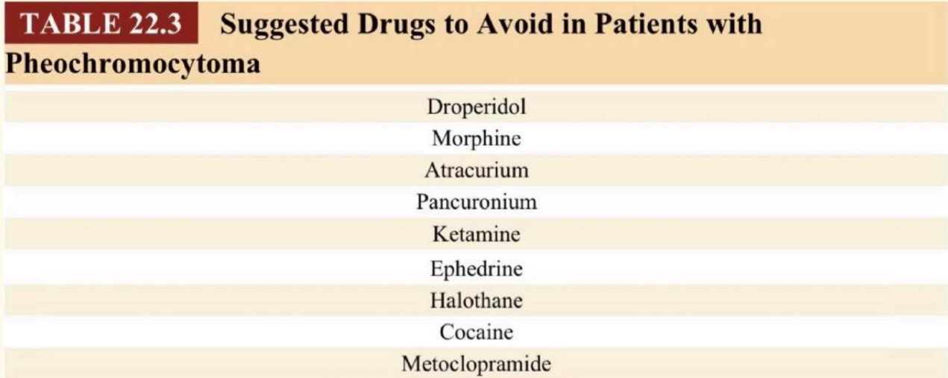
Avoiding drug-induced catecholamine release

Slide 42
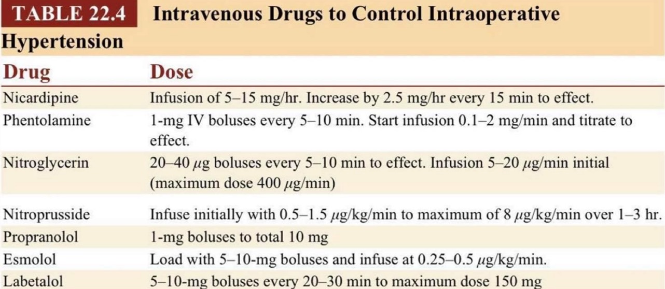
Minimizing haemodynamic responses to tumour handling

Slide 43
Choice of anesthesia

Slide 44
Preparation

Slide 45
General preparation
Informed consent
NPO
NSS 1,000 ml IV rate 120 ml/hr
Adequate hydration keep euvolemia
Warm IV fluid
Force air warmer
Standard monitoring : EKG , NIBP , O2sat , ETCO2, BT
Anesthetic machine
IV anesthesia
Intubation equipment

Slide 46
Specific preparation
Invasive monitoring :
A-line
C-line
Large bore IV
Postop ICU
IV Anti-HT drugs : NTG , Esmolol, Nicardipine
Vasopressor : NE
G/M Blood component : PRC 4 unit, FFP 4 unit, Pooled Plt 2 unit
Pre-medication :
- Propanolol (10) 2 tab po
- Doxazocin (2) 2 tab po

Slide 47
Intraoperative management

Slide 48
GA c ETT c Controlled ventilation
Standard Monitoring : EKG, NIBP, O2 sat, ETCO2, BT
Specific Monitoring : A-line, C-line
Position : Supine

Slide 49
Start Anes BP 135/95 mmHg PR 59 bpm
Induction :Propofol 120+30 mg
Intubation: Cisatracurium 8 mg
A-line no.20 at Lt. Radial artery

Slide 50
ETT 7.0 depth 20cm LV grade 1 by Mc intosh No.3
BP 150/90 mmHg after intubation
Maintainance: Air:O2 1:1 Sevoflurane 2%
C-line 3 lumen at Rt. IJ 12 cm
Iv no.22,18 at LH,RH

Slide 51
Start surgery 10.05 น.
BP 100/60 mmHg PR 65 bpm

Slide 52
Manipulate tumor at
10:55 : BP 140/85 mmHg : Nicardipine 0.2 mg IV

Slide 53
Ligate tumor at 11:15
BP 134/80 mmHg
Remove tumor at 11:18
BP 80-100/40-50 mmHg
-> Levophed 4 mcg IV x II
-> Start Levophed (1:25) IV titrate 0.1-0.2 mcg/kg/min
DTX 110 mg%

Slide 54
Onsia 8 mg IV at 11:45

Slide 55
Reverse : Neostigmine 2.5 mg + Atropine 1.2 mg -> Extubation
IV fluid : total 800 ml EBL : 50 ml
Urine output : 520 ml
Operation time : 3 Hr 45 min Transfer to SICU : BP before transfer 130/80 mmHg

Slide 56
Postoperative D1
S :ตื่นดี ปวดแผล PS at rest 1 , activity 3 ไม่มีไข้ หายใจปกติ ปัสสาวะออกดี
O : BP 101/79 mmHg BT 37.5°C RR 18 bpm HR 80 bpm I/O 3,133/1,723 Hct 28.3%, DTX 80 mg%
A + P : S/P Left open adrenectomy
จิบน้ำ
Morphine 4 mg IV q 6hr
Morphine 2 mg IV prn for pain q 2hr
Plasil 10 mg IV prn q 8 hr
Keep euvolemia
Acetar 1,000 ml IV rate 80 ml/hr
5%DN/2 1,000 ml IV rate 60 ml/hr
Levophed (1:25) IV rate 0.003 mcg/kg/min

Slide 57
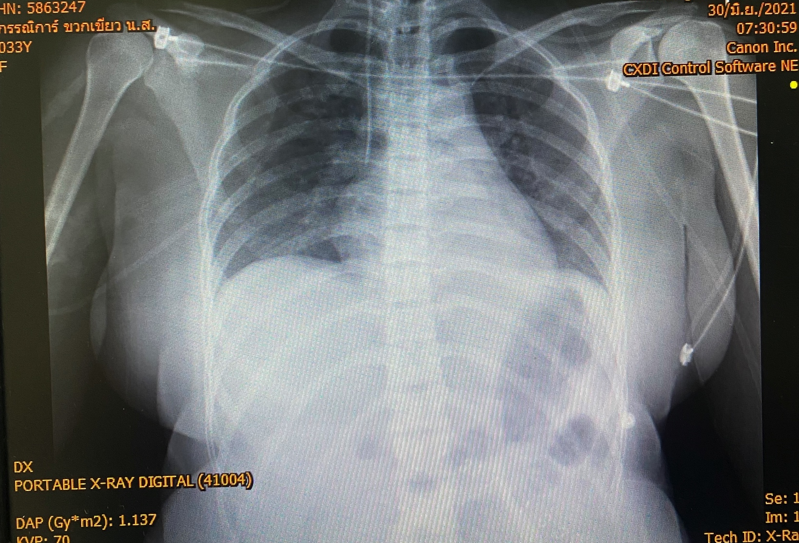
Postoperative

Slide 58
Postoperative D2
S :ตื่นดี ปวดแผล PS at rest 0 , activity 2 ไม่มีไข้ หายใจปกติ ปัสสาวะออกดี
O : BP 113/65 mmHg BT 37.4°C RR 18 bpm HR 84 bpm I/O 2,000/1,825 Hct 29.8%, DTX 87 mg%
A + P : S/P Left open adrenectomy
Liquid diet
Morphine 4 mg IV q 6hr
Morphine 2 mg IV prn for pain q 2hr
Plasil 10 mg IV prn q 8 hr
Paracetamol (500) 1 tab po prn q 4-6hr
5%DN/2 1,000 ml IV rate 80 ml/hr

Slide 59
Postoperative

Slide 60
Postoperative complications
Profound hypotension
Severe hypertension
Rebound hypoglycemia

Slide 61
THANK YOU

