Slide 1
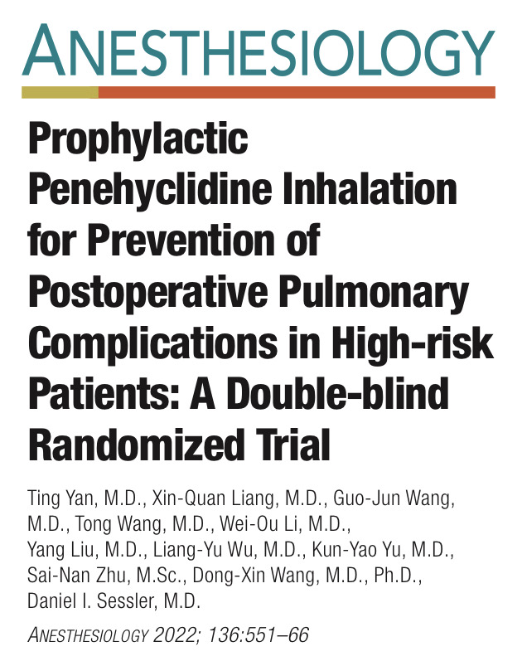
R3 Chanathip Meerod
Maj.Kollawat Sirapalanon

Slide 2
Background
Postoperative pulmonary complications are common and associated with prolonged hospitalization, increased cost, perioperative mortality
Aging and respiratory disease provoke airway hyperresponsiveness , high risk surgery induces diaphragmatic dysfunction
General anesthesia contributes to atelectasis and peripheral airway injury
Preventive Strategies include smoking cessation, preoperative respiratory training, neuraxial anesthesia, lung protective ventilation, MIS, postoperative CPAP, early mobilization

Slide 3
Background
Perioperative muscarinic antagonists may improve pulmonary function and reduce pulmonary complications
penehyclidine is a long acting antimuscarinic with high selective M3 receptor
It is effective for treatment exacerbation of COPD and ARDS, possibly by dilating bronchioles, improve pulmonary compliance, inhibiting airway inflammation

Slide 4
Hypothesis
Inhalation of penehyclidine reduces a composite of pulmonary complications
in high risk noncardiac surgical patients over the initial 30 postoperative days

Slide 5
Material and methods
Single center trial was performed in Peking university
The study protocol was approved by the local clinical research ethics committee
Registered with the Chinese clinical trial registry

Slide 6
Inclusion criteria
Age ≥ 50 yr.
Upper abdominal or noncardiac thoracic surgery
( at least 2 hr. or 5 cm long incision)
Assess respiratory risk ( Catalonia score ≥45 )

Slide 7
Exclusion criteria
Uncooperative during inhalation therapy
Moderate to severe symptomatic prostatic hypertrophy or narrow angle glaucoma
Used inhaled B agonist, antimuscarinic, glucocorticoid within 1 month
stroke within 3 months, CRRT , hepatic disease ( Child-Pugh C)
MI, severe heart dysfunction, tachyarrhythmia in 1 yr. , ASA ≥ 4
Participated in other drug trials within 1 preoperative month

Slide 8
Randomization
Random allocations were generated 1:1 ratio by SAS 9.2 software
Penehyclidine ( 1 mg) and water placebo were provided as clear solutions
Treatment allocations were sealed in sequentially numbered opaque envelopes that were opened by pharmacist who wasn't involved in trial
Investigators, clinicians and patients were fully blinded to treatment

Slide 9
Preparation
Penehyclidine (0.5/0.5ml)+ NSS to 6 ml added to nebulizer q 12 hr. before surgery
Inhaled trial was given with jet nebulizer with 5-8 LPM ( non-intubated)
Vibrating mask nebulizer for intubated patient after surgery
Inhalation twice daily for 4 days
( 1 day before, 1 day during, and 2 day after surgery)

Slide 10
Perioperative management
NIBP,EKG, O₂ saturation, EtCO₂ & inhale anesthetic ,urine output, temperature, BIS monitoring
A-line , C-line were monitored when necessary
General endotracheal anesthesia was induced
Induction : propofol / etomidate
Intubation : cisatracurium / rocuronium
Narcotic : remifentanil / sufentanil
Maintenance : sevoflurane ± N₂O
Ventilator setting : TV 6-8 ml/kg ( two lung ventilation) , 5-7 ml/kg ( one lung ventilation)
PEEP 0-5 cmH₂O , keep O₂sat > 90%

Slide 11
Perioperative management
Fluid management was per clinical routine
Keep Hb> 7 g/dl
The end of surgery , patients were extubated and transferred to PACU at least 30 min
before transfer to ward or ICU
Intubated patients were sedated with propofol / dexmedetomidine + opioids
Postoperative mechanical ventilation : Bilevel ventilation mode
Extubating : regained consciousness & protective airway reflex , normal hemodynamic
Fully recovered from paralysis per clinical assessment

Slide 12
Perioperative management
Pain control : multimodal analgesia + PCA/PCEA
NRS ≤ 3
Postoperative pulmonary complications were treated per routine practice
including inhalation therapy

Slide 13
Outcomes
Primary outcome
Incidence of postoperative pulmonary complications that occurred within 30 postoperative days
Secondary outcome
Postoperative time to onset of PPC
Number of individual PPC
Incidence of extrapulmonary complications
Length of hospital stay
30 day all cause mortality

Slide 14
Statistical analysis
Sample size were assumed from pilot study
365 patients/group + 15% drop out rate = 432 patients/group
Primary outcome : Chi-square test, difference between groups expressed as
relative risk and 95% CI
Secondary outcome : categorical data – chi-square/Fisher exact test
Time to event : Kaplan-Meier survival , Discrete variables : Mann-Whitney U test
Statistical significant : P value < 0.05

Slide 15
Enrollment

Slide 16
Baseline characteristics

Slide 17
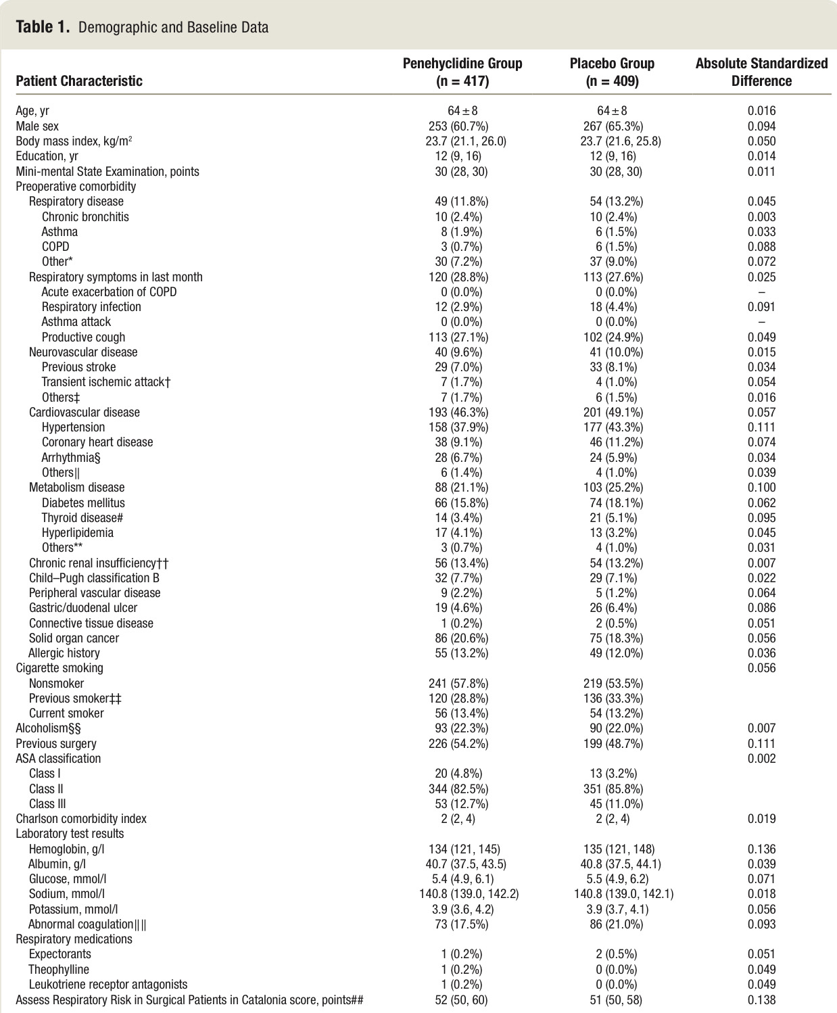
Baseline characteristics
Penehyclidine : lung tumors were slightly common
: mediastinal tumors slightly less common

Slide 19
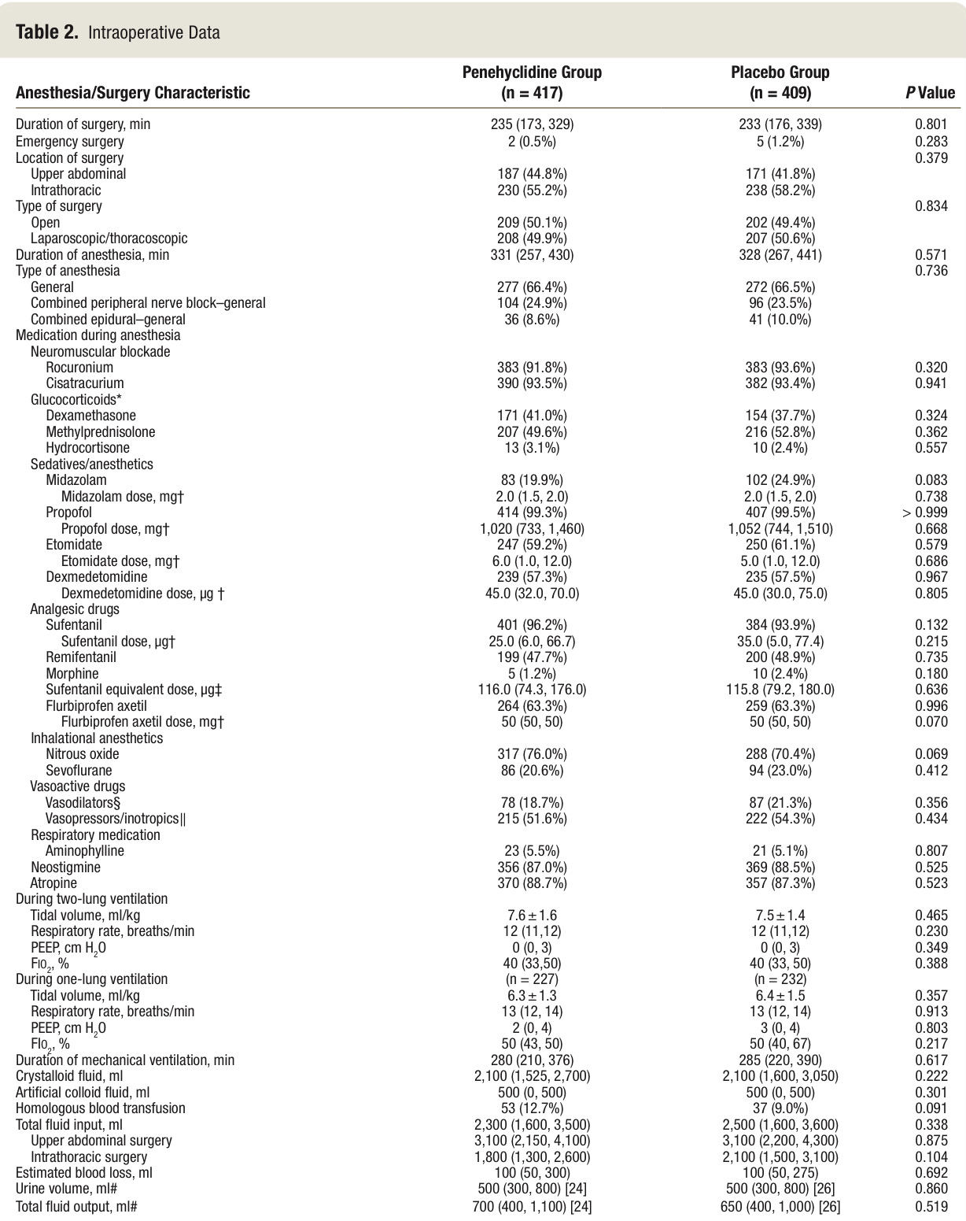

Slide 21
Effectiveness outcomes

Slide 22
Primary outcome

Slide 23
Effectiveness outcomes

Slide 24
Subgroup analyses

Slide 25
Safety outcomes
No severe adverse outcomes

Slide 26
Discussion
The mechanism of penehyclidine inhalation provides pulmonary protection that bronchodilation and reduced respiratory resistance
Indeed, they reduced intraoperative high airway pressure & bronchospasm that explaining why antimuscarinic reduce pulmonary complications
Acetylcholine-induced response decreased with age and diminished by respiratory mechanic in obese patients

Slide 27
Discussion
Other clinical outcomes weren’t significant improved because extrapulmonary complications remained common and similar in each group
Anticholinergic reactions are uncommon after aerosolized because so little of the drug is systemically absorbed

Slide 28
Limitations
Single center trial, excluded patients already used inhaled drugs
The benefits of penehyclidine will presumably differ in other population
Presumably the results would vary with other penehyclidine dosing
Penehyclidine is not approved by U.S.FDA , tiotropium is available in U.S. but it isn’t labeled for prophylactic use

Slide 29
Critical Appraisal : RCT
Does this study address a clear question?

Slide 30
Critical Appraisal : RCT
Are the results of this single trial valid?

Slide 31
Critical Appraisal : RCT
Are the results of this single trial valid?

Slide 32
Critical Appraisal : RCT
What were the results?
yes
yes

Slide 33
Critical Appraisal : RCT
Can I apply these valid, important results to my patients?

Slide 34
Thank you

