Slide 1
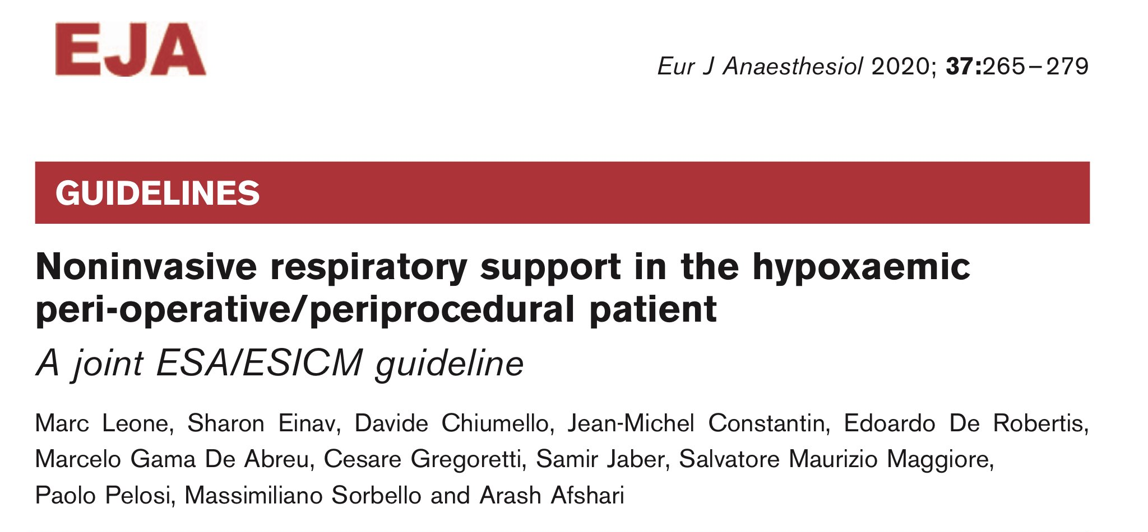
Title Layout
R1 Pattiya Puttasinpornskul
A.Wanwipha Malaithong

Slide 2
Introduction
Hypoxemia is a potential life-threatening common complication in the peri-operative period.
The ESA and the ESICM have developed guidelines for the use of noninvasive respiratory support in hypoxemic patients.
Notes:
Hypoxemia 21-55% of pt during 48h postop evev MIS sx
ESA European society of Anesthesiology
ESICM European Society of Intensive care medicine

Slide 3
Introduction
Noninvasive respiratory support techniques
Conventional oxygen therapy (COT)
High flow nasal canula (HFNC)
Noninvasive positive pressure ventilation (NIPPV)
Continuous Positive airway pressure (CPAP)
Notes:
Hypoxemia 21-55% of pt during 48h postop evev MIS sx
ESA European society of Anesthesiology
ESICM European Society of Intensive care medicine

Slide 4
Introduction
The literature search strategy was developed by a Cochrane Anesthesia and Intensive Care trial.
The GRADE system was used to assess the level of evidence and to grade recommendations

Slide 5
Summary of recommendations
What goals of therapy can be achieved with each noninvasive respiratory support technique in the postoperative/periprocedual hypoxemic patient with acute respiratory failure?
Which patients may benefit from the use of noninvasive respiratory support techniques for hypoxemic patients with acute respiratory failure?

Slide 6
Summary of recommendations
Which minimal standards of hemodynamic and respiratory monitoring and what laboratory and radiological test are requiring during the support period?
What are the (ways to prevent) avoidable complication in patients receiving various types of noninvasive respiratory support?
How and where to initiate non invasive respiratory support?

Slide 7
Material and Methods
The ESA and the ESICM nominated a joint panel of experts to develop guidelines for the use of noninvasive respiratory support.

Slide 8
Objective
To evaluate the various noninvasive respiratory support techniques in hypoxemic patients.
To compare the efficacy and safety of HFNC, NIPPV and CPAP with each other and with COT

Slide 9
Definitions
COT : low-flow oxegen (≤ 15 L/min) delivered jeither by nasal canula or face mask
Hypoxemia : ratio between the PaO₂:FiO₂ ratio below 40 kPa (300 mmHg)

Slide 10
Criteria for inclusion of studies for data analysis
Types of study : RCTs, Retrospective studies, reviews, case series, and case reports
Types of participant : Adult hypoxemic patients(≥16 years) requiring noninvasive respiratory support
Types of intervention : HFNC, CPAP, NIPPV
Type of comparators : COT, among interventions
Type of outcome: clinical outcome, physiological parameter (PaO₂:FiO₂ ratio )

Slide 11
Search methods for identification of studied

Slide 12
Assessment of risk of bias in included studies
Random sequence generation (selection bias)
Allocation concealment (selection bias)
Blinding of outcome assessors (performance and detection bias)
Incomplete outcome data, intention-to-treat (attrition bias)
Selective reporting

Slide 13
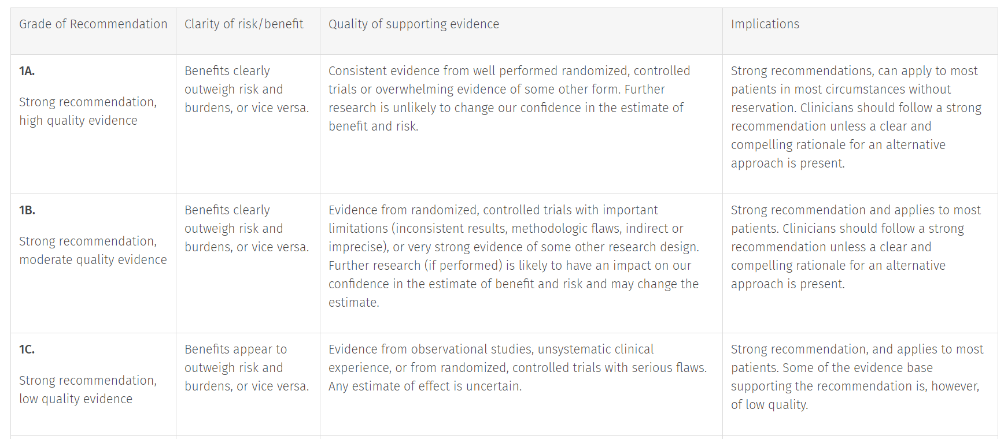
Assessment of quality of the evidence

Slide 14
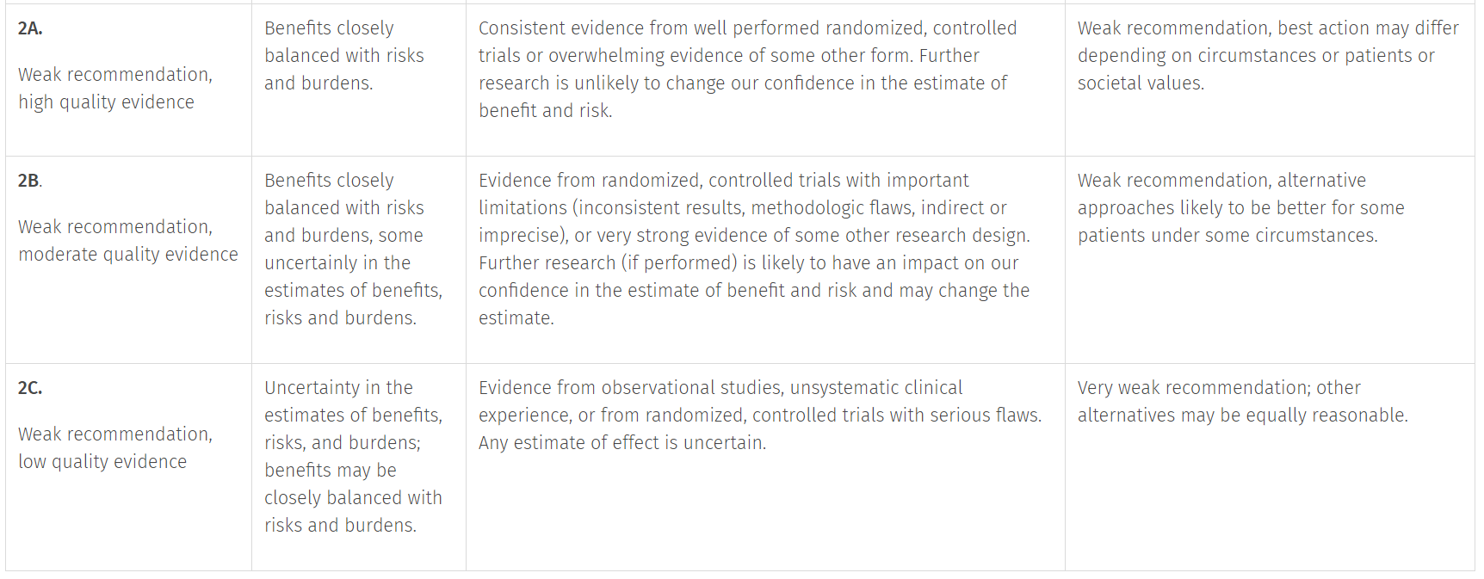
Assessment of quality of the evidence

Slide 15
Query1
What goals of therapy can be achieved with each noninvasive respiratory support technique in the postoperative/periprocedual hypoxemic patient with acute respiratory failure?

Slide 16
Query1
What goals of therapy can be achieved with each noninvasive respiratory support technique in the postoperative/periprocedual hypoxemic patient with acute respiratory failure?
Improvement of oxygenation
Reducing the risk of pulmonary complication – atelectasis and pneumonia
Avoiding reintubation
Reducing mortality

Slide 17
Improvement of oxygenation

Slide 18
Reducing the risk of pulmonary complication – atelectasis and pneumonia

Slide 19
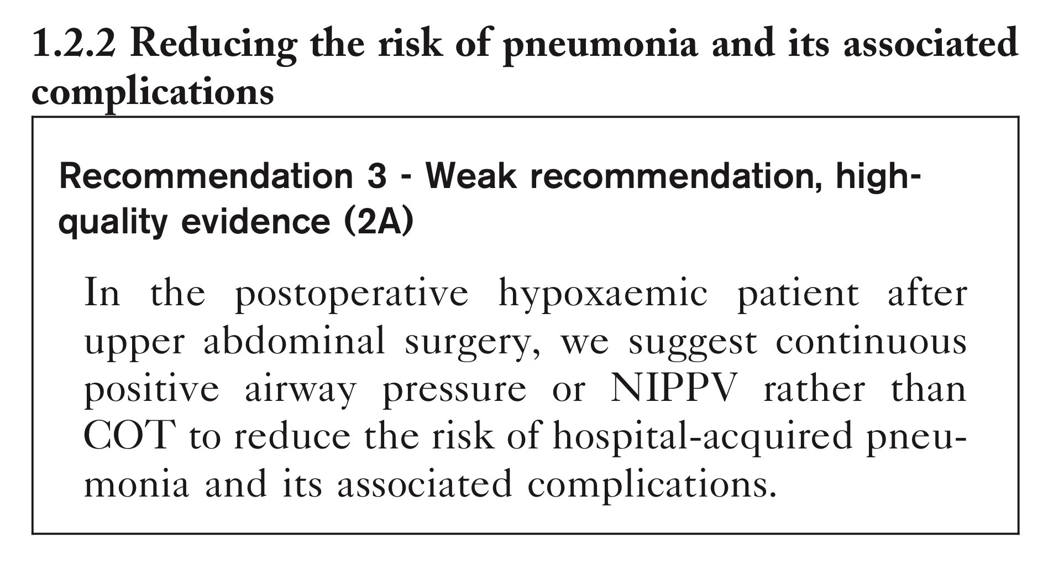
Reducing the risk of pulmonary complication – atelectasis and pneumonia

Slide 20
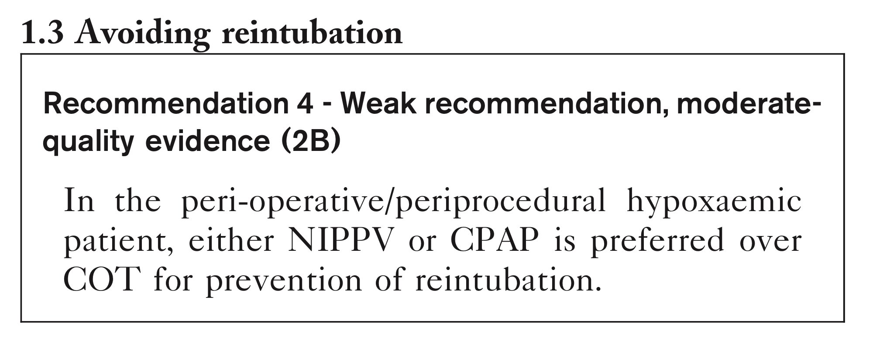
Avoiding reintubation

Slide 21
Reducing mortality

Slide 22
Query2
Which patients may benefit from the use of noninvasive respiratory support techniques for hypoxemic patients with acute respiratory failure?

Slide 23
Query2
Which patients may benefit from the use of noninvasive respiratory support techniques for hypoxemic patients with acute respiratory failure?
Postabdominal surgery
Postcardiac surgery
Postlung resection
Posttransplant
During fibreoptic bronchoscopy

Slide 24
Postabdominal surgery

Slide 25
Postcardiac surgery

Slide 26
Postlung resection

Slide 27
Posttransplant

Slide 28
During fibreoptic bronchoscopy

Slide 29
Query3
Which minimal standards of hemodynamic and respiratory monitoring and what laboratory and radiological test are requiring during the support period?

Slide 30
Query3
Which minimal standards of hemodynamic and respiratory monitoring and what laboratory and radiological test are requiring during the support period?
Competence and skill
Clinical examination
Physiological monitoring
Blood sampling
Radiological testing

Slide 31
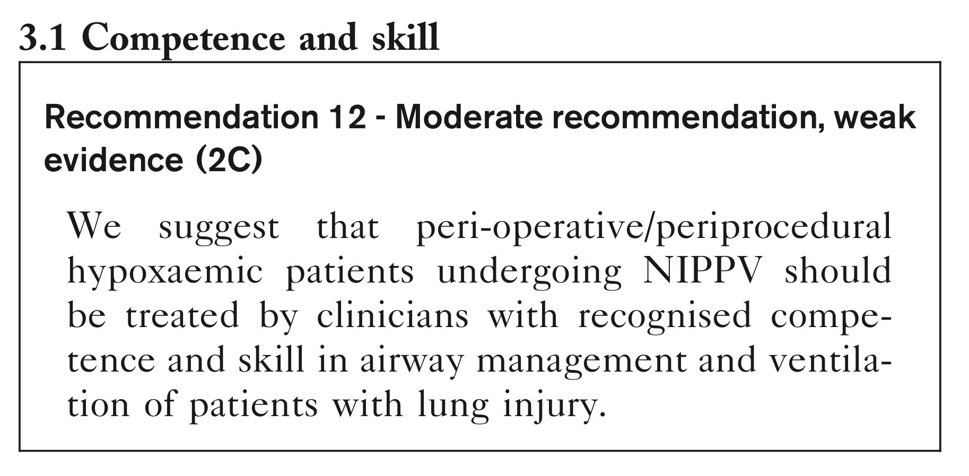
Competence and skill

Slide 32
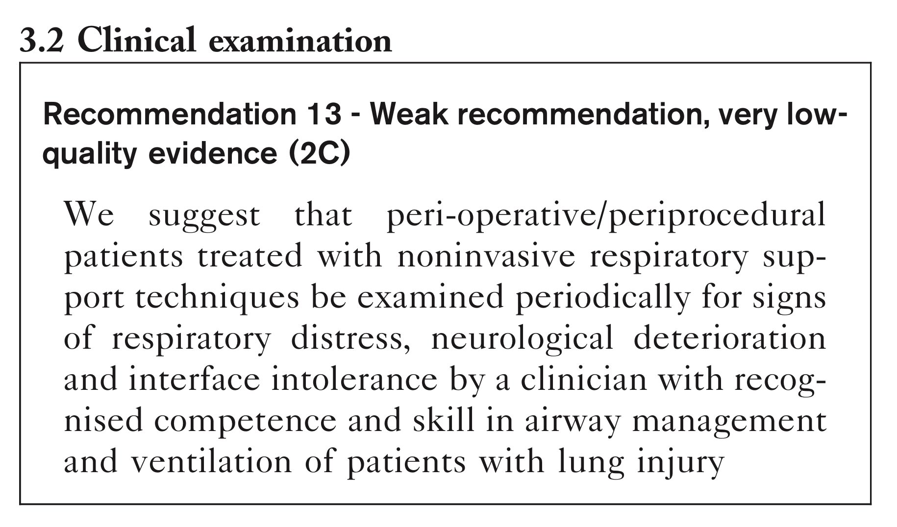
Clinical examination

Slide 33
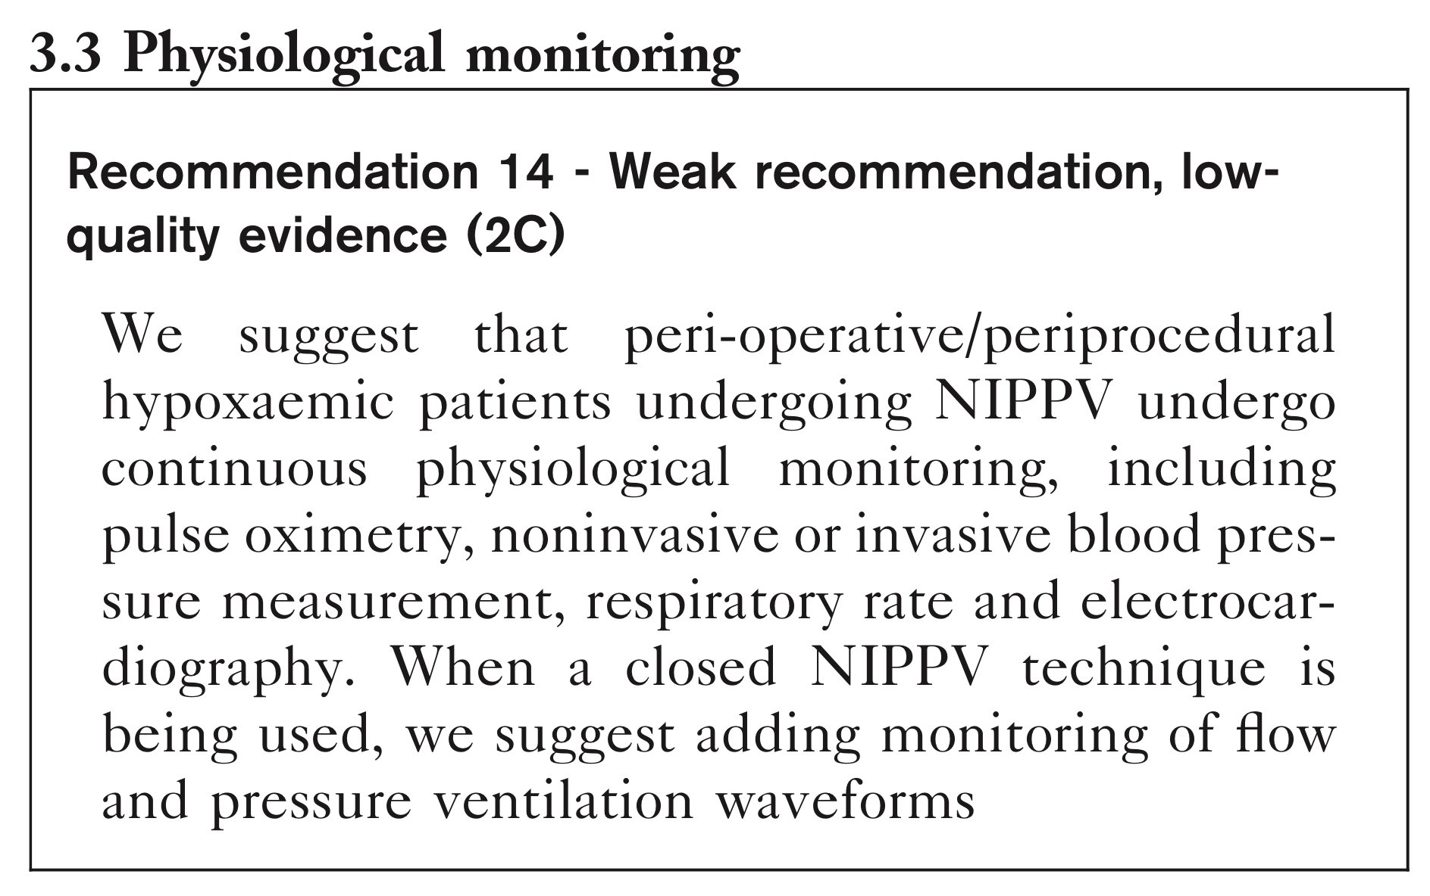
Physiological monitoring

Slide 34
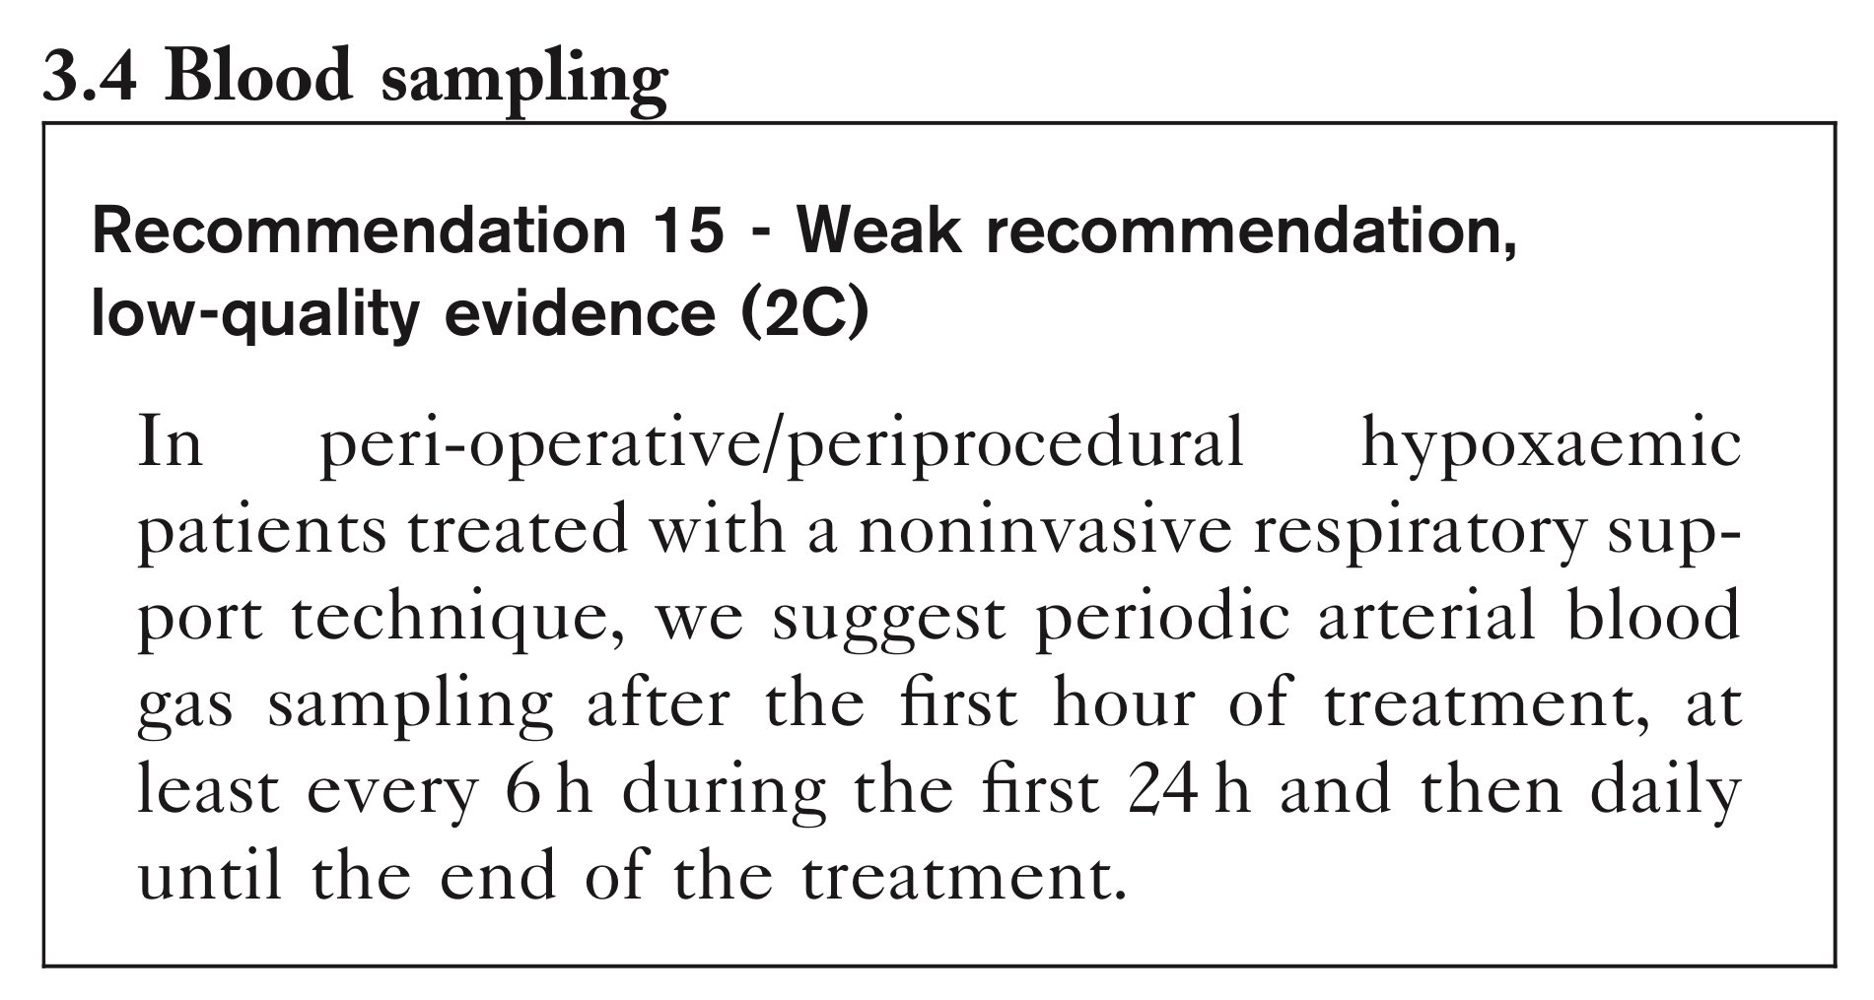
Blood sampling

Slide 35
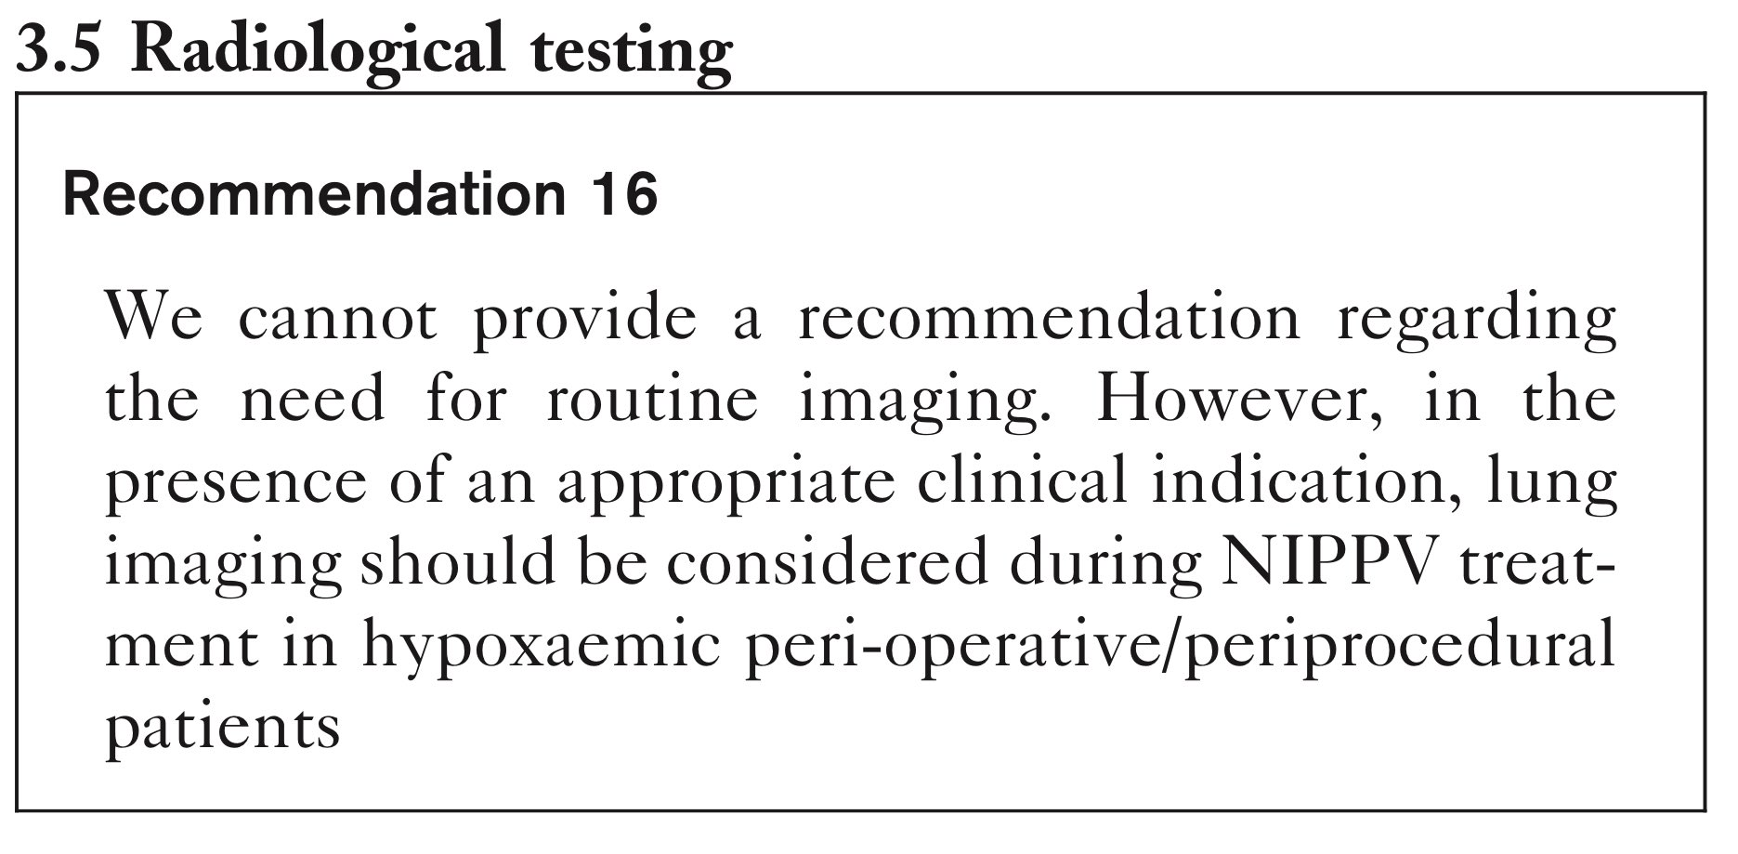
Radiological testing

Slide 36
Query4
What are the (ways to prevent) avoidable complication in patients receiving various types of noninvasive respiratory support?

Slide 37
Query4
What are the (ways to prevent) avoidable complication in patients receiving various types of noninvasive respiratory support?

Slide 38
Query4
What are the (ways to prevent) avoidable complication in patients receiving various types of noninvasive respiratory support?

Slide 39
Query5:How and where to initiate non invasive respiratory support?

Slide 40
Discussion
Postoperative hypoxemic patients are at increased risk of postoperative pulmonary complications
1st, The use of NIPPV or CPAP to improve oxygenation and to prevent the risk of reintubation
The use of NIPPV reduced the mortality rate compared with COT
2nd, NIPPV or CPAP performs better than COT after abdominal surgery and lung resection
HFNC may have a role after cardiothoracic surgery

Slide 41
Discussion
3rd, No recommendation
4th, No recommendation
5th, No recommendation

Slide 42
Discussion
Limitations
Population selected based on literature identified
Significant heterogenicity in the study group: no large RCTs
Peri-operative/periprocedural patients outcomes affected by surgery/procedure
No consensual definition of hypoxemia

Slide 43
Conclusion
Joint ESA/ESICM guideline on oxygenation of the hypoxemic postoperative patient
19 recommendations
goals of therapy
target group
clinical assessment and monitoring requirements
prevention of complications and the location of care

Slide 44
Journal Appraisal

Slide 45
Journal Appraisal

Slide 46
Journal Appraisal

Slide 47
Journal Appraisal

Slide 48
Journal Appraisal

Slide 49
THANK YOU

